Slide 1
SharePoint Basics

Slide 2
What is SharePoint?
SharePoint is a secure place to store, organize, share, and access information from any device.
Organizations use SharePoint to create websites.

Slide 3
Why SharePoint?
Context around documents and folders.
Enable constant communication with all staff.
Store all information in a central location.
Encourage Collaboration.

Slide 4
Why SharePoint Important?
To store document in more effective format than regular folder system.
Bring an organization together so that everyone receives critical information that is relevant to them.

Slide 5
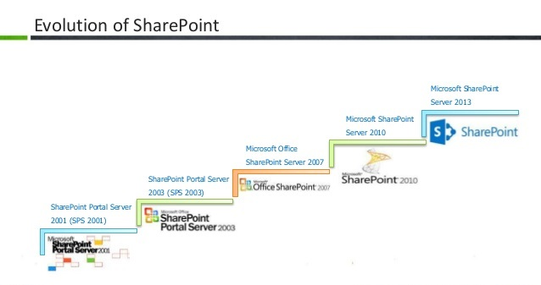

Slide 6
The First Versions of SharePoint
SharePoint Portal Server was launched in 2001.
Focused mainly on document management.
Drawbacks
Unattractive interface
Lack of customisation
malfunctioning

Slide 7
SharePoint 2003
Microsoft released Windows SharePoint Server as part of Windows Server 2003.
It had an improved user interface, better personalization, and a collaboration store.
SharePoint 2007
Provides fully functional and integrated content management system
Being more of a collaborative platform, allowing end users more interaction.

Slide 8
SharePoint 2010
SharePoint 2010 provided enhanced capabilities like better integration with other Office applications.
It empowered staff at all levels by providing services to improve and expand business connectivity.
It also automated the workflow process, which had a major impact on business efficiency.

Slide 9
SharePoint 2013
Support mobile users, which has meant a vast improvement in business service delivery.
Upload documents into specific folders and libraries for easy retrieval.
Accommodates much larger data sets that can be compressed and filtered while in the server’s memory.
Improved features for the design of company sites and the layout of content.
PC-based services to cloud-based.

Slide 10
Types of Platforms
On Premise(on site)
Full customization
Robust security and confidentiality
High data integrity
Online(in the cloud)
Much less management
High availability
Less cost
Does not require an IT team
Hybrid(best of both)

Slide 11
Features of SharePoint
Content Management:
File Sharing, Check In, Check out, Versioning, MS Office Integration, Document ID, Records Declaration, Retention and disposal policies.
Social Computing:
Enables Advanced Collaboration within the SharePoint environment. Supports Wikis , Blogs, Forums, Meeting through community portals.

Slide 12
Identity Management:
Authentication enhancements supporting claims based, server –to-server and app-based authentication mechanism.
Mobile Computing:
SharePoint supports optimized viewing experiences across mobile platforms.
Branding:
Custom design of site pages through customization of html, css and JavaScript.

Slide 13
Search:
Enterprise search on documents, metadata, items. Search indexing for faster results. Search scopes for external content look up.
Business Intelligence:
Manage your organizational goals and performance through the Business Intelligence feature of SharePoint including excel services, Visio services, dashboard etc.

Slide 14
SharePoint Architecture

